Slide 1
Using Bayesian Optimization in Pose Graphs Based SLAM 23rd June
Zuxun Wang

Slide 2
Progress Since Last Meeting
Writing Project Introduction
Based on the feedback provided, modified the introduction.
Generate the Consistency Measurement Metric graph
Omega values from 1.0 -> 1.9, with stride 0.1
Try to improve the code using nested parfor loop [failed]
Nested parfor loops are not allowed in MATLAB
==> try to linearise the loops, but the computation of meanChi2 and covChi2 relies on the input values of omega scales for both R and Q.
Current solution: use for loop for omega values, parfor for running episodes.

Slide 3
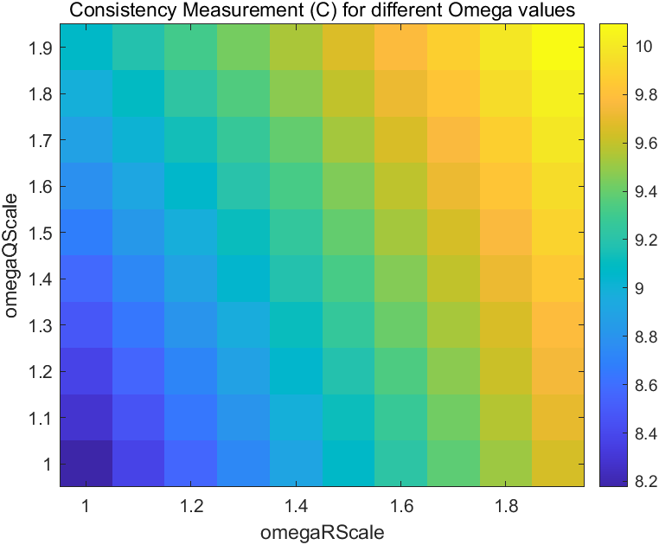
Consistency Measurement Metric

Slide 4
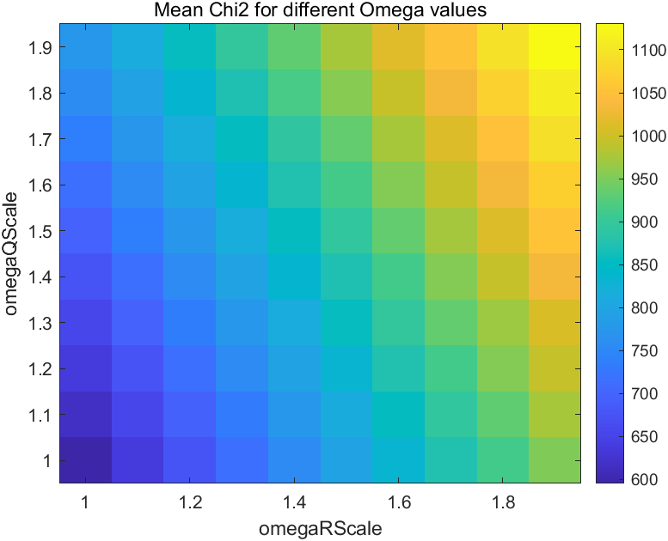
Mean of chi2

Slide 5
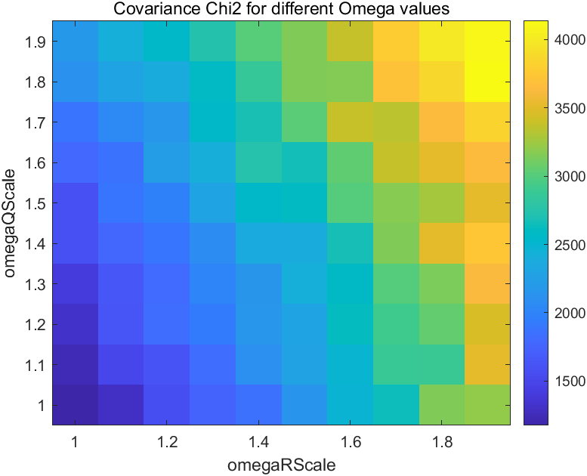
Chi2 covariance

Slide 6
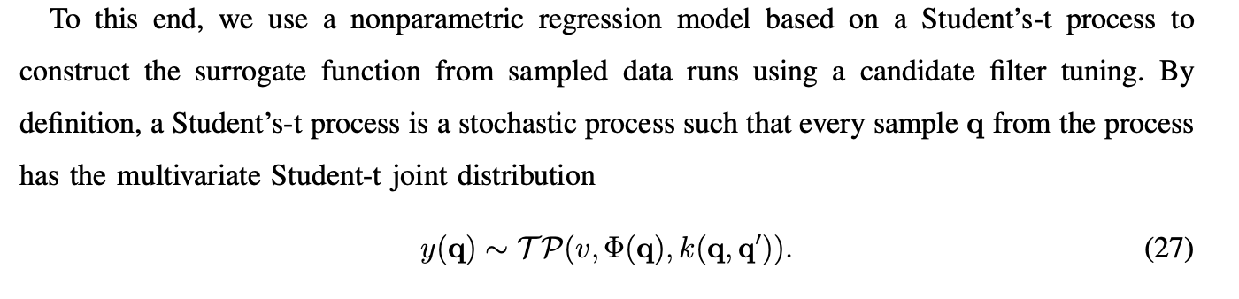
Problems / Issues
In Section VI-B of the AES paper, when introducing the surrogate model, what is actually sampled from the Student’s-t process?
For equation (27), which one is what we are sampling, $q$ or $y(q)$(function of $q$)?

Slide 7
Problems / Issues
When doing Bayesian Optimisation, will we going to use any other library, or other programming languages/platforms other than MALTAB?
Will we use C++ or PyTorch (BoTorch) in Python?

Slide 8
Planned Activities
Start to look into Bayesian Optimisation
Try to compute Consistency Measurement for nonlinear cases
LandmarkVehicleTrackingExample.m
gpsVehicleTrackingExample.m
Any suggestion?
I will experiment with generating a mesh grid specifying a set of (omegaRScale, omegaQScale) values and implement parfor accordingly.
I will also expand my scale tests from 0.1 to 1.9 to verify the location of the minimum.
For the nonlinear example, I'll work on reducing the noise to avoid weird looping.

